Slide 1
18CSC205J – Operating Systems – Unit V
STORAGE MANAGEMENT
AND
FILE MANAGEMENT

Slide 2
Course Learning Rationale and Course Learning Outcomes
Course Learning Rationale
Realize the significance of Device management part of an Operating System
Comprehend the need of File management functions of an Operating System
Course Learning Outcomes
Find the significance of device management role of an Operating system
Recognize the essentials of File Management of an Operating system

Slide 3
STORAGE MANAGEMENT
Understanding the Basics in storage management
Mass storage structure
Overview of Mass storage structure
Magnetic Disks
Disk Scheduling
Understanding the various scheduling with respect to the disk

Slide 4
Basics in storage management
Definition:
Management of the data storage equipment’s that are used to store the user/computer generated data.
It is a process for users to optimize the use of storage devices and to protect the integrity of data for any media on which it resides.
It contain the different type of subcategories such as security, virtualization and more, as well as different types of provisioning or automation, which is generally made up the entire storage management software market

Slide 5
Storage management key attributes
Performance
Reliability
Recoverability
Capacity

Slide 6
Features of Storage Management
Storage management is a process that is used to optimize the use of storage devices.
Storage management must be allocated and managed as a resource in order to truly benefit a corporation.
Storage management is generally a basic system component of information systems.
It is used to improve the performance of their data storage resources.

Slide 7
Advantages of Storage Management
It is very simple to managed a storage capacity.
It is generally take a less time.
It is improve the performance of system.
In virtualization and automation technologies can help an organization improve its agility.

Slide 8
Three Phases of Storage Management
Initial allocation
Recovery
Compaction and reuse
Partial Compaction
Full Compaction

Slide 9
Initial Allocation
Initially each piece of storage is either free or in use.
If free, it is available for dynamic allocation as the execution proceeds.
A storage management system needed several methods to hold track of free storage and structure for free storage allocation as the need appears during execution

Slide 10
Recovery
The storage that has been allocated and in use, must be recovered by the storage manager when the allocated storage becomes available for reuse.
This involves finding the data objects which are no longer referenced and reclaim that memory.

Slide 11
Compaction and Reuse
The storage recovered can be directly ready for reuse, or compaction can be essential to generate large blocks of free storage from small elements.
As the computation proceeds, the storage block is disintegrated into smaller elements through allocation, recovery, and reuse.

Slide 12
Types of Compaction
Partial compaction − If it is too expensive to shift active blocks (or active blocks cannot be transformed), then only contiguous free blocks on the free-space list can be compacted.
Full compaction − If active blocks can be transformed, thus all active blocks can be transformed to one end of the heap, leaving all void at the additional is contiguous block.

Slide 13
Overview of Mass Storage Structure
Magnetic Disks
Disks are the mainly used mass storage devices. They provide the bulk of secondary storage in operating systems today.
One or more platters in the form of disks covered with magnetic media.
Each platter has two working surfaces.
Each working surface is divided into a number of concentric rings called tracks.
The collection of all tracks that are the same distance from the edge of the platter, ( i.e. all tracks immediately above one another in the following diagram ) is called a cylinder.

Slide 14
Magnetic Disks - Contd
Each track is further divided into sectors, traditionally containing 512 bytes of data each, although some modern disks occasionally use larger sector sizes.
The data on a hard drive is read by read-write heads.
The standard configuration uses one head per surface, each on a separate arm, and controlled by a common arm assembly which moves all heads simultaneously from one cylinder to another.

Slide 15
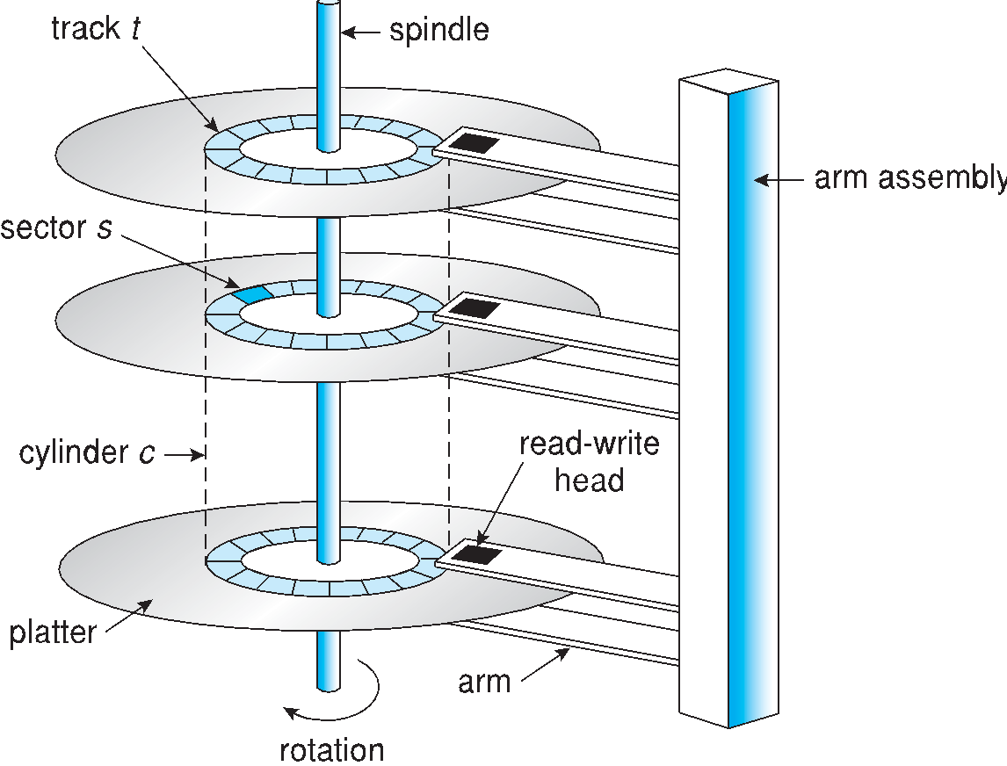
Moving-head Disk Mechanism

Slide 16
Magnetic Disks - Contd
The positioning time, or seek time or random access time is the time required to move the heads from one cylinder to another, and for the heads to settle down after the move.
The rotational latency is the amount of time required for the desired sector to rotate around and come under the read-write head.
The transfer rate, which is the time required to move the data electronically from the disk to the computer.
Disk Access Time: Disk Access = Seek time + Rotational latency + Transfer time

Slide 17
Magnetic Tapes
Magnetic tapes were once used for common secondary storage before the days of hard disk drives, but today are used primarily for backups.
Accessing a particular spot on a magnetic tape can be slow, but once reading or writing commences, access speeds are comparable to disk drives.
Capacities of tape drives can range from 20 to 200 GB, and compression can double that capacity.

Slide 18
Solid-State Disks
SSDs are especially useful as a high-speed cache of hard-disk information that must be accessed quickly. One example is to store filesystem meta-data, e.g. directory and inode information, that must be accessed quickly and often.
SSDs are also used in laptops to make them smaller, faster, and lighter.
Because SSDs are so much faster than traditional hard disks, the throughput of the bus can become a limiting factor, causing some SSDs to be connected directly to the system PCI bus for example.

Slide 19
Example Problem on HDD performance
Question: Consider a disk with a rotational rate of 10,000 RPM, an average seek time of 8 ms, and an average of 500 sectors per track. Estimate the average time to read a random sector from disk. Do this by summing the estimates of the seek time, rotational latency, and transfer time.

Slide 20
Answer:
The average access time is the sum of the seek time, rotational latency, and transfer time.
The seek time is given as 8ms. Once the head is in the right place, on average we will need to wait for half a rotation of the disk for the correct sector to come under the head. Thus, on average, the rotational latency is half the time it takes the disk to make a complete revolution.
The disk spins at 10000 RPM, so it takes 1/10000 of a minute to make one revolution. Equivalently, (1000 ms/sec × 60 sec/minute) / 10000 RPM = 6 ms to make one revolution. So rotational latency is 3ms.
The transfer time is the time it takes for the head to read all of the sector. The head is now at the start of the sector, so how long does it take for the entire sector to go past the head? Since there are on average 500 sectors per track, we need 1/500th of a revolution of the disk to read the entire sector. We can work this out as (time for one revolution of disk) / 500 = 6ms / 500 = 0.012ms.
So the total time is 8ms + 3ms + 0.012ms ≈ 11ms. We can clearly see that getting to read the first byte of the sector takes a long time, but reading the rest of the bytes in the sector is essentially free.

Slide 21
Disk Scheduling
Introduction to Disk Scheduling
Why Disk Scheduling is Important
Disk Scheduling Algorithms
FCFS
SSTF
SCAN
C-SCAN
LOOK
C-LOOK
- Disk Management

Slide 22
Disk Scheduling
What is Disk Scheduling?
Disk scheduling is done by operating systems to schedule I/O requests arriving for the disk. Disk scheduling is also known as I/O scheduling.
Introduction
The operating system is responsible for using hardware efficiently — for the disk drives, this means having a fast access time and disk bandwidth
Minimize seek time
Seek time ≈ seek distance
Disk bandwidth is the total number of bytes transferred, divided by the total time between the first request for service and the completion of the last transfer
There are many sources of disk I/O request
OS
System processes
Users processes

Slide 23
Introduction - contd
I/O request includes input or output mode, disk address, memory address, number of sectors to transfer
OS maintains queue of requests, per disk or device
Idle disk can immediately work on I/O request, busy disk means work must queue
Optimization algorithms only make sense when a queue exists

Slide 24
Why Disk Scheduling is Important?
Disk scheduling is important because:
Multiple I/O requests may arrive by different processes and only one I/O request can be served at a time by the disk controller. Thus other I/O requests need to wait in the waiting queue and need to be scheduled.
Two or more request may be far from each other so can result in greater disk arm movement.
Hard drives are one of the slowest parts of the computer system and thus need to be accessed in an efficient manner.
Note that drive controllers have small buffers and can manage a queue of I/O requests (of varying “depth”)
Several algorithms exist to schedule the servicing of disk I/O requests
The analysis is true for one or many platters

Slide 25
Disk Scheduling Algorithms
Disk Scheduling Algorithms
FCFS
SSTF
SCAN
C-SCAN
LOOK
C-LOOK

Slide 26
Disk Scheduling Algorithm - Example
Consider a disk queue with requests for I/O to blocks on cylinders 98, 183, 41, 122, 14, 124, 65, 67. The FCFS,SSTF,SCAN,C-SCAN,LOOK, and C-LOOK scheduling algorithm is used. The head is initially at cylinder number 53. The cylinders are numbered from 0 to 199. The total head movement (in number of cylinders) incurred while servicing these requests is _______.

Slide 27
1. FCFS(First Come First Serve)
FCFS is the simplest of all the Disk Scheduling Algorithms. In FCFS, the requests are addressed in the order they arrive in the disk queue.
head is initially at cylinder number 53. The cylinders are numbered from 0 to 199.
98, 183, 41, 122, 14, 124, 65, 67
1. (98-53)=45
2. (183-98)=85
3. (183-41)=142
4. (122-41)=81
5. 122-14=108
6. 124-14-110
7. 124-65=59
8.67-65=2

Slide 28
FCFS(contd..)
Total head movements using FCFS= [(98 – 53) + (183 – 98) + (183 – 41) + (122 – 41) + (122 – 14) + (124 – 14) + (124 – 65) + (67 – 65)]
= 45 + 85 + 142 + 81 + 108 + 110 + 59 + 2
=632
Advantages:
Every request gets a fair chance
No indefinite postponement
Disadvantages:
Does not try to optimize seek time
May not provide the best possible service

Slide 29
2. SSTF(Shortest Seek Time First)
Shortest Seek Time First (SSTF) selects the request with the minimum seek time from the current head position
SSTF scheduling is a form of SJF scheduling; may cause starvation of some requests
As a result, the request near the disk arm will get executed first. SSTF is certainly an improvement over FCFS as it decreases the average response time and increases the throughput of system.
Advantages:
Average Response Time decreases
Throughput increases
Disadvantages:
Overhead to calculate seek time in advance
Can cause Starvation for a request if it has higher seek time as compared to incoming requests
High variance of response time as SSTF favours only some requests

Slide 30

SSTF(contd…)
head is initially at cylinder number 53. The cylinders are numbered from 0 to 199.
98, 183, 41, 122, 14, 124, 65, 67
Total head movement using SSTF=(65-53)+(67-65)+(67-41)+(41-14)+(98-14)+ (122-98)+(124-122)+(183-124)
=12+2+26+27+84+24+2+59=236)

Slide 31
3. SCAN
The disk arm starts at one end of the disk, and moves toward the other end, servicing requests until it gets to the other end of the disk, where the head movement is reversed and servicing continues.
SCAN algorithm Sometimes called the elevator algorithm
As a result, the requests at the midrange are serviced more and those arriving behind the disk arm will have to wait.
Advantages:
High throughput
Low variance of response time
Average response time
Disadvantages:
Long waiting time for requests for locations just visited by disk arm

Slide 32
SCAN or Elevator((1st Solution)
head is initially at cylinder number 53. The cylinders are numbered from 0 to 199.
98, 183, 41, 122, 14, 124, 65, 67
Total Head Movement using SCAN=[(65-53)+(67-65)+(98-67)+(122-98)+(124-122)+(183-124)+(199-183)+(199-41)+
(41-14)]
=12+2+31+24+2+59+16+158+27)=331

Slide 33
SCAN or Elevator(2nd Solution)- Best Choice
head is initially at cylinder number 53. The cylinders are numbered from 0 to 199.
98, 183, 41, 122, 14, 124, 65, 67
Total Head Movement using SCAN=[(53-41)+(41-14)+(14-0)+(65-0)+(67-65)+ (98-67)+(122-98)+(124-122)+(183-124)]
=12+27+14+65+2+31+24+59
= 234

Slide 34
4. C-SCAN
The head moves from one end of the disk to the other, servicing requests as it goes
When it reaches the other end, however, it immediately returns to the beginning of the disk, without servicing any requests on the return trip
Treats the cylinders as a circular list that wraps around from the last cylinder to the first one
Provides a more uniform wait time than SCAN
Advantages:
Provides more uniform wait time compared to SCAN

Slide 35
C-SCAN(contd…)
head is initially at cylinder number 53. The cylinders are numbered from 0 to 199.
98, 183, 41, 122, 14, 124, 65, 67
Total Head Movement using C-SCAN=[(65-53)+(67-65)+(98-67)+(122-98)+(124-122)+(183-124)+(199-183)+(199-0)+(14-0)+(41-14)]
=12+2+31+24+2+59+16+199+14+27)=386

Slide 36
5. LOOK
It is similar to the SCAN disk scheduling algorithm except for the difference that the disk arm in spite of going to the end of the disk goes only to the last request to be serviced in front of the head and then reverses its direction from there only. Thus it prevents the extra delay which occurred due to unnecessary traversal to the end of the disk.

Slide 37
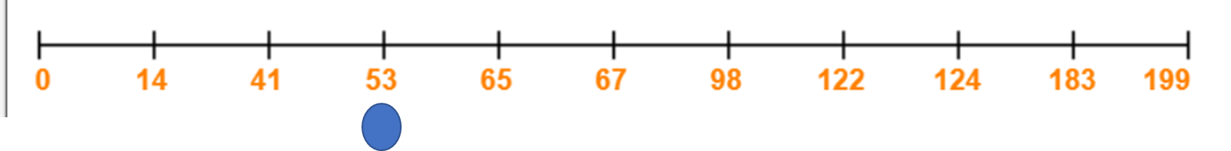
LOOK(Contd…)
head is initially at cylinder number 53. The cylinders are numbered from 0 to 199.
98, 183, 41, 122, 14, 124, 65, 67
Total Head Movement using look=[(65-53)+(67-65)+(98-67)+(122-98)+(124-122)+ (183-124)+(183-41)+(41-14)]
=12+2+31+24+2+59+142+27)=299

Slide 38
6. C-LOOK
LOOK a version of SCAN, C-LOOK a version of C-SCAN
Arm only goes as far as the last request in each direction, then reverses direction immediately, without first going all the way to the end of the disk
In CLOOK, the disk arm in spite of going to the end goes only to the last request to be serviced in front of the head and then from there goes to the other end’s last request. Thus, it also prevents the extra delay which occurred due to unnecessary traversal to the end of the disk.

Slide 39
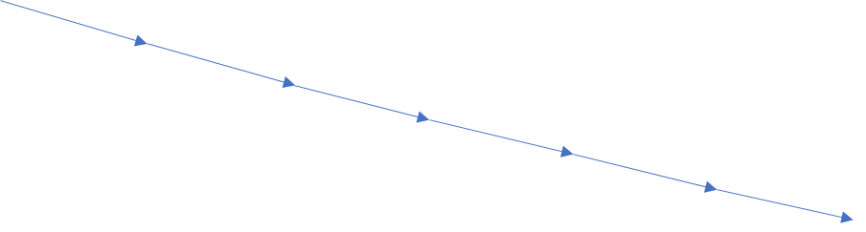
C- LOOK(contd…)
head is initially at cylinder number 53. The cylinders are numbered from 0 to 199.
98, 183, 41, 122, 14, 124, 65, 67
Total Head Movement using C-LOOK=[(65-53)+(67-65)+(98-67)+(122-98)+(124-122)+(183-124)+(183-14)+ (41-14)]
= 12+2+31+24+2+59+169+27)=326

Slide 40
No.of Head movements of All Algorithms
Total head movements
1.FCFS=632
2.SSTF=232
3.SCAN=331or 234
4. C-SCAN=386
5.LOOK=299
6.C-SCAN=326

Slide 41
Selection of a Disk-Scheduling Algorithm
SSTF is common and has a natural appeal
SCAN and C-SCAN perform better for systems that place a heavy load on the disk
Less starvation
Performance depends on the number and types of requests
Requests for disk service can be influenced by the file-allocation method
And metadata layout
The disk-scheduling algorithm should be written as a separate module of the operating system, allowing it to be replaced with a different algorithm if necessary
Either SSTF or LOOK is a reasonable choice for the default algorithm
What about rotational latency?
Difficult for OS to calculate
How does disk-based queueing effect OS queue ordering efforts?

Slide 42
Disk Management
Low-level formatting, or physical formatting — Dividing a disk into sectors that the disk controller can read and write
Each sector can hold header information, plus data, plus error correction code (ECC)
Usually 512 bytes of data but can be selectable
To use a disk to hold files, the operating system still needs to record its own data structures on the disk
Partition the disk into one or more groups of cylinders, each treated as a logical disk
Logical formatting or “making a file system”
To increase efficiency most file systems group blocks into clusters
Disk I/O done in blocks
File I/O done in clusters

Slide 43
Disk Management (Cont.)
Raw disk access for apps that want to do their own block management, keep OS out of the way (databases for example)
Boot block initializes system
The bootstrap is stored in ROM
Bootstrap loader program stored in boot blocks of boot partition
Methods such as sector sparing used to handle bad blocks

Slide 44
File System Interface
File Concept
File Access Methods
File Sharing and Protection
Objective
To explain the function of file systems
To describe the interfaces to file systems
To discuss file-system design tradeoffs, including access methods, file sharing, file locking, and structures

Slide 45
File Concept
A file is a named collection of related information that is recorded on secondary storage such as magnetic disks, magnetic tapes and optical disks. In general, a file is a sequence of bits, bytes, lines or records whose meaning is defined by the files creator and user.
Files are the most important mechanism for storing data permanently on mass-storage devices. Permanently means that the data is not lost when the machine is switched off. Files can contain:
data in a format that can be interpreted by programs, but not easily by humans (binary files);
alphanumeric characters, codified in a standard way (e.g., using ASCII or Unicode), and directly readable by a human user (text files). Text files are normally organized in a sequence of lines, each containing a sequence of characters and ending with a special character (usually the newline character). Consider, for example, a Java program stored in a file on the hard-disk. In this unit we will deal only with text files.
Each file is characterized by a name and a directory in which the file is placed (one may consider the whole path that allows one to find the file on the hard-disk as part of the name of the file).

Slide 46
File Attributes
Name: It is the only information stored in a human-readable form.
Identifier: Every file is identified by a unique tag number within a file system known as an identifier.
Location: Points to file location on device.
Type: This attribute is required for systems that support various types of files.
Size. Attribute used to display the current file size.
Protection. This attribute assigns and controls the access rights of reading, writing, and executing the file.
Time, date and security: It is used for protection, security, and also used for monitoring

Slide 47
File Operations
1. Create
Creation of the file is the most important operation on the file. Different types of files are created by different methods for example text editors are used to create a text file, word processors are used to create a word file and Image editors are used to create the image files.
2. Write
Writing the file is different from creating the file. The OS maintains a write pointer for every file which points to the position in the file from which, the data needs to be written.
3. Read
Every file is opened in three different modes : Read, Write and append. A Read pointer is maintained by the OS, pointing to the position up to which, the data has been read.

Slide 48
File Operations
4. Re-position
Re-positioning is simply moving the file pointers forward or backward depending upon the user's requirement. It is also called as seeking.
5. Delete
Deleting the file will not only delete all the data stored inside the file, It also deletes all the attributes of the file. The space which is allocated to the file will now become available and can be allocated to the other files.
6.Truncate
Truncating is simply deleting the file except deleting attributes. The file is not completely deleted although the information stored inside the file get replaced.

Slide 49
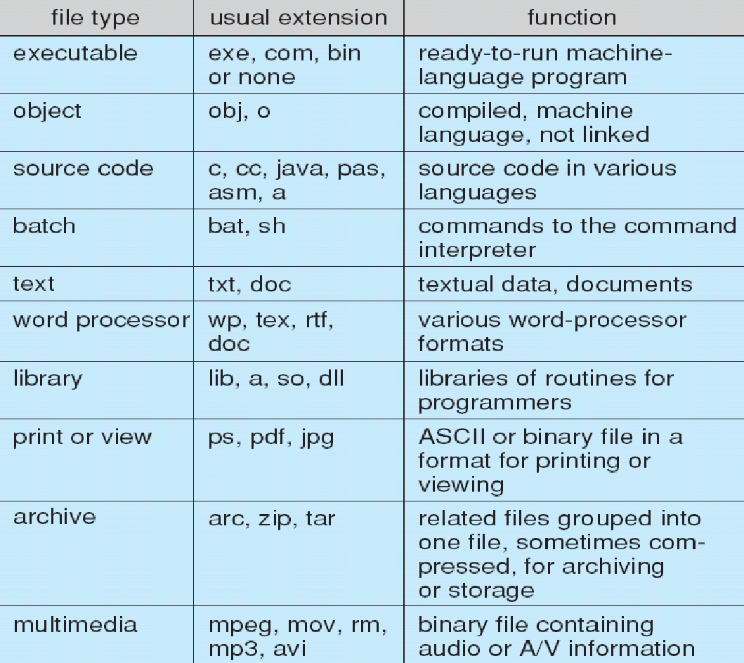
File Types – Names,Extension

Slide 50
File Structure
A file has a certain defined structure according to its type.
A text file is a sequence of characters organized into lines.
A source file is a sequence of procedures and functions.
An object file is a sequence of bytes organized into blocks that are understandable by the machine.
When operating system defines different file structures, it also contains the code to support these file structure. Unix, MS-DOS support minimum number of file structure.

Slide 51
File Structure
File Structure classification
None- Sequence of words,bytes
Simple Record Structure – Lines, Fixed and Variable Length
Complex Structure – Formatted Document, Relocatable load file

Slide 52
File Access Methods
File Access Methods
Sequential
Direct
Hashed

Slide 53
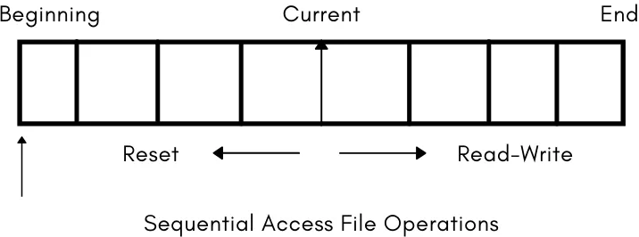
File Access Methods
Sequential Access Method: – Sequential Access Method is one of the simplest file access methods. Most of the OS (operating system) uses a sequential access method to access the file. In this method, word by word, the operating system read the file, and we have a pointer that points the file’s base address. If we need to read the file’s first word, then there is a pointer that offers the word which we want to read and increment the value of the word by 1, and till the end of the file, this process will continue.

Slide 54
Sequential Access Method
Key Operations:
Read next
Write next
Reset (or Rewind)
The Read Operation – read next – reads the next portion of the file that is currently in access, also the read next advances the file pointer which is responsible for tracking the I/O operations.
The Write Operation – write next – write operation will add a new node at the end of the file and move the pointer to the new end of the file where the newly written information is stored.
Reset (or rewind) – reset operation will bring the file read or write head at the beginning of the file.
The sequential file access method depicts the example of how a tape drive worked, one memory block at a time and then the next block followed.
Advantage – The sequential access method is an easy implementation method for the software and hardware.
Disadvantage – The sequential access takes a lot of time for performing the read-write operation.

Slide 55
Direct Access Methods
Direct Access Method is also called the Relative access method. The various records can be read or write randomly. There is no restriction on the order of reading or writing for a direct access file. This method is also known as relative access method and is typically used in systems implementing disks rather than magnetic tapes. In direct access method, the various records or blocks of a file are numbered for reference purpose. In order to perform read or write operation, we specify block number where read or write operation is to be performed.
In the Database System, we mostly use the Direct Access Method. In most of the situations, there is a need for information in the filtered form from the database. And in that case, the speed of sequential access may be low and not efficient.
In direct access method it is possible to access the records of a file in any order (i.e. out of order). For example, if we are reading block 13, we can read block 46 after this and then block 20.

Slide 56
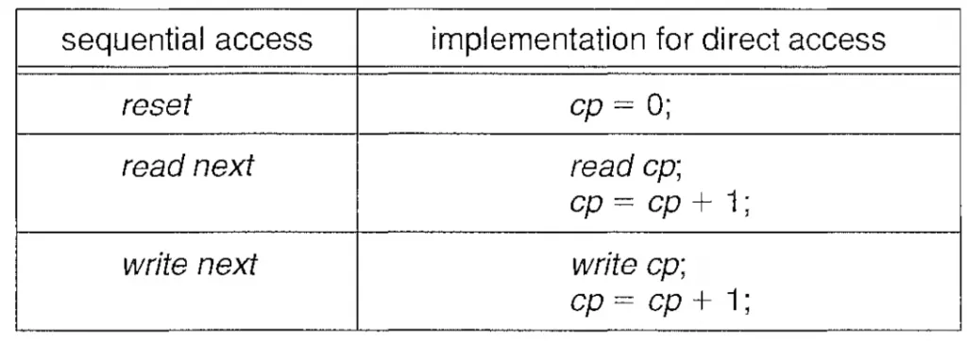
Direct Access Methods
Direct access file operation
Read n
Write n
Goto n
‘n’ represents the block number.
We can simulate the sequential access method with the direct access method but vice versa can be inefficient and complex.

Slide 57
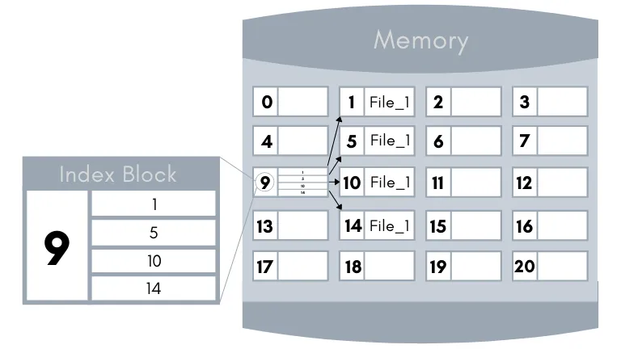
Index Access Methods
The Index Access method is an improvised version of the direct access method. In this method, an index is maintained which contains the address (or pointers) of the file blocks. So, to access any particular record of the file the operating system will first search its address in the index and the index will then point to the actual address of the particular block of the file that has the desired information.

Slide 58
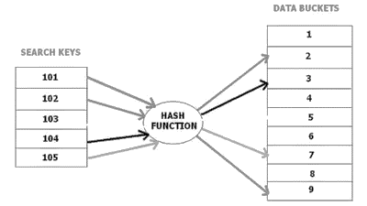
Hashed Access Methods
Hashing is an ideal method to calculate the direct location of a data record on the disk without using index structure. Hashing method is used to index and retrieve items in a database as it is faster to search that specific item using the shorter hashed key instead of using its original value.
Data bucket : Data buckets are memory locations where the records are stored. It is also known as Unit Of Storage.
Hash function : A hash function, is a mapping function which maps all the set of search keys to the address where actual records are placed.
Hash index : It is an address of the data block. A hash function could be a simple mathematical function to even a complex mathematical function.

Slide 59
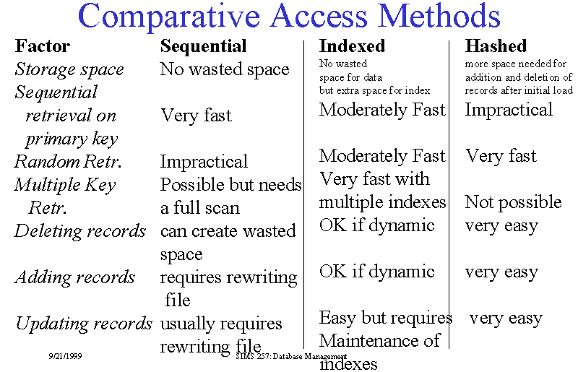

Slide 60
File Access Methods
3. Index Access Method: – Index Access Method is another essential method of file, accessing. In this method, for a file an index is created, and the index is just like an index which is at the back of the book. The index includes the pointer to the different blocks. If we want to find a record in the file, then first, we search in the index, and after that, with the help of the pointer, we can directly access the file.
In the Index Access method, we can search fast in the large database, and also easy. But in this, the method need some additional space to store the value of the index in the memory.
Key Points:
On top of the sequential access method, the index access method is built.
The Index access method can control the pointer with the help of the index.

Slide 61
File Sharing

Slide 62
Objective of File sharing
For multiple users-File sharing, file naming and file protection is a challenging and important task.
In order to handle this, file access control and protection need to be done.
If a user wants to share a file with other user, proper protection schemes need to be followed.
Whenever a file is shared for various users on distributed systems , it must be shared across distributed systems.
In order to share and distribute files, Network File System (NFS) is used.
For single user system ,the system need to maintain many files and directory attributes.

Slide 63
File sharing-Multiple Users
Many file systems evolved with the concept of file (or directory) owner (or user) and group.
The owner is the user who can change attributes and grant access and who has the most control over the file.
The group attribute defines a subset of users who can share access to the file.
For example, the owner of a file on a UNIX system can issue all operations on a file, while members of the file’s group can execute one subset of those operations, and all other users can execute another subset of operations. Exactly which operations can be executed by group members and other users is definable by the file’s owner

Slide 64
File sharing-Remote File Systems
The communication among remote computers uses the concept called Networking that allows the sharing of resources spread across a campus or even around the world.
The first implemented method for file sharing involves manually transferring files between machines via programs like ftp.
The second major method for file sharing uses a distributed file system (DFS) in which remote directories are visible from a local machine.
The third method for file sharing , uses WorldWide Web, is a reversion to the first.
A browser is needed to gain access to the remote files, and separate operations (essentially a wrapper for ftp) are used to transfer files.
Increasingly, cloud computing is being used for file sharing as well.

Slide 65
File sharing-Remote File Systems
ftp is used for both anonymous and authenticated access.
Anonymous access allows a user to transfer files without having an account on the remote system.
TheWorldWideWeb uses anonymous file exchange almost exclusively.
DFS involves a much tighter integration between the machine that is accessing the remote files and the machine providing the files.

Slide 66
File sharing-Remote File Systems
Remote File Systems
Client –Server Model
Distributed Information Systems
Failure Modes

Slide 67
File sharing-Remote File Systems- Client Server Model
The machine containing the files is the server, and the machine seeking access to the files is the client.
The server can serve multiple clients, and a client can use multiple servers, depending on the implementation details of a given client–server facility.
Example:
NFS is standard UNIX client-server file sharing protocol
CIFS is standard Windows protocol
Standard operating system file calls are translated into remote calls

Slide 68
File sharing -Distributed Information Systems
Distributed Information Systems (distributed naming services) such as LDAP, DNS, NIS, Active Directory implement unified access to information needed for remote computing
Examples:
Other distributed information systems provide user name/password/user ID/group ID space for a distributed facility.
UNIX systems have employed a wide variety of distributed information methods.
Sun Microsystems introduced yellow pages (since renamed network information service, or NIS), and most of the industry adopted its use.

Slide 69
File Sharing -Failure Modes
All file systems have failure modes
For example corruption of directory structures or other non-user data, called metadata
Remote file systems add new failure modes, due to network failure, server failure
Recovery from failure can involve state information about status of each remote request
Stateless protocols such as NFS v3 include all information in each request, allowing easy recovery but less security

Slide 70
File Sharing-Consistency Semantics
Consistency semantics represent an important criterion for evaluating any file system that supports file sharing.
These semantics specify how multiple users of a system are to access a shared file simultaneously.
In particular, they specify when modifications of data by one user will be observable by other users.
These semantics are typically implemented as code with the file system.
Consistency semantics are directly related to the process synchronization algorithms

Slide 71
File sharing - Consistency Semantics
Consistency Semantics
UNIX-Semantics
Session Semantics
Immutable Shared File Semantics

Slide 72
File Sharing-Consistency Semantics- Unix Semantics
The UNIX file system uses the following consistency semantics:
Writes to an open file by a user are visible immediately to other users who have this file open.
One mode of sharing allows users to share the pointer of current location into the file. Thus, the advancing of the pointer by one user affects all sharing users. Here, a file has a single image that interleaves all accesses, regardless of their origin.

Slide 73
File Sharing-Consistency Semantics- Session Semantics
The Andrew file system (OpenAFS) uses the following consistency semantics:
Writes to an open file by a user are not visible immediately to other users that have the same file open.
Once a file is closed, the changes made to it are visible only in sessions starting later. Already open instances of the file do not reflect these changes.
According to these semantics, a file may be associated temporarily with several (possibly different) images at the same time.

Slide 74
File Sharing-Consistency Semantics-Immutable-Shared-Files Semantics
A unique approach is that of immutable shared files.
Once a file is declared as shared by its creator, it cannot be modified. An immutable file has two key properties: its name may not be reused, and its contents may not be altered.
Thus, the name of an immutable file signifies that the contents of the file are fixed.
The implementation of these semantics in a distributed system

Slide 75
File Protection-Objective
When information is stored in a computer system, we want to keep it safe from physical damage (the issue of reliability) and improper access (the issue of protection).
Reliability is generally provided by duplicate copies of files.
Many computers have systems programs that automatically (or through computer-operator intervention) copy disk files to tape at regular intervals (once per day or week or month) to maintain a copy should a file system be accidentally destroyed.
File systems can be damaged by hardware problems (such as errors in reading or writing), power surges or failures, head crashes, dirt, temperature extremes, and vandalism.
Files may be deleted accidentally. Bugs in the file-system software can also cause file contents to be lost

Slide 76
Protection
Protection can be provided in many ways. Protection mechanisms provide controlled access by limiting the types of file access that can be made.
Read. Read from the file.
Write. Write or rewrite the file.
Execute. Load the file into memory and execute it.
Append. Write new information at the end of the file.
Delete. Delete the file and free its space for possible reuse.
List. List the name and attributes of the file.
Other operations, such as renaming, copying, and editing the file, may also be controlled.

Slide 77
Protection-Access Control
The most general scheme to implement identity dependent access is to associate with each file and directory an access-control list (ACL) specifying user names and the types of access allowed for each user.
When a user requests access to a particular file, the operating system checks the access list associated with that file.
If that user is listed for the requested access, the access is allowed. Otherwise, a protection violation occurs, and the user job is denied access to the file.

Slide 78

Protection-Access Control
Mode of access: read(4 bits), write(2 bits), execute(1 bit)
Three classes of users on Unix / Linux(Default Permission)
RWX
a) owner access 7 ⇒ 1 1 1 RWX
b) group access 6 ⇒ 1 1 0
RWX
c) public access 1 ⇒ 0 0 1
To change Permissions the following commands are used :
Chmod: Change Mode(For files)
Chown: Change Owner(For Files)
Chgroup: Change group permission(For files)

Slide 79
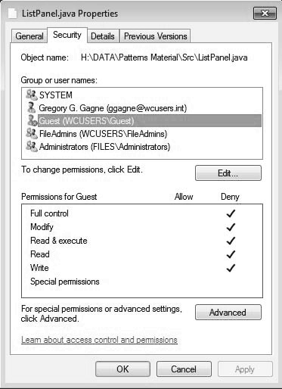
Protection-Access Control-Control List Management
Example:
Windows users typically manage access-control lists via the GUI. Figure shows a file-permission window on Windows 7 NTFS file system. In this example, user “guest” is specifically denied access to the file ListPanel.java

Slide 80

Unix File Permission Example
While using ls -l command, it displays various information related to file permission as follows :
The first column represents different access modes, i.e., the permission associated with a file or a directory.
The permissions are broken into groups of threes, and each position in the group denotes a specific permission, in this order: read (r), write (w), execute (x) −
The first three characters (2-4) represent the permissions for the file's owner. For example, -rwxr-xr-- represents that the owner has read (r), write (w) and execute (x) permission.
The second group of three characters (5-7) consists of the permissions for the group to which the file belongs. For example, -rwxr-xr-- represents that the group has read (r) and execute (x) permission, but no write permission.
The last group of three characters (8-10) represents the permissions for everyone else. For example, -rwxr-xr-- represents that there is read (r) only permission.

Slide 81
File System Implementation
File System Implementation
- File System Structure
- Directory Implementation
- File Allocation Methods
- Swap Space Management

Slide 82
Objectives of File System Implementation
It helps to understand the file system structure
It helps to apprehend about how the files and folders are organized in the directory structure and its classification
To describe the implementation of remote file systems
To discuss block allocation and free-block algorithms and trade-offs
To describe the details of implementing local file systems and directory structures

Slide 83
File-System Structure
File structure
Logical storage unit
Collection of related information
File system resides on secondary storage (disks)
Provided user interface to storage, mapping logical to physical
Provides efficient and convenient access to disk by allowing data to be stored, located retrieved easily
Disk provides in-place rewrite and random access
I/O transfers performed in blocks of sectors (usually 512 bytes)
File control block – storage structure consisting of information about a file
Device driver controls the physical device
File system organized into layers

Slide 84
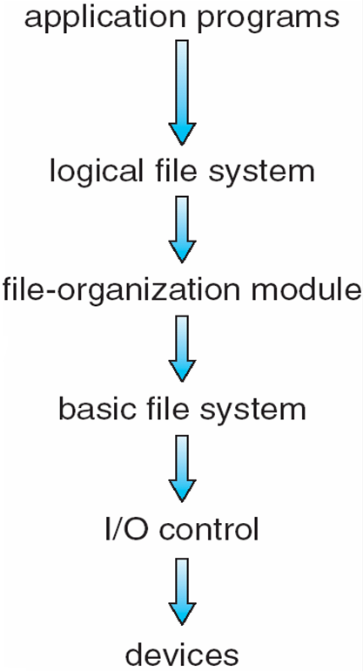
Layered File System
application program asks for a file, the first request is directed to the logical file system.
The logical file system contains the Meta data information of the file and directory structure and provides protection also. It translates file name into file number, file handle, location by maintaining file control blocks (inodes in UNIX)
The logical blocks of files need to be mapped to physical blocks in harddisk. This mapping is done by File organization module
The basic file system - issues the commands to I/O control in order to fetch those blocks. Basic file system given command like “retrieve block 123” translates to device driver.
I/O controls contain the codes by using which it can access hard disk.
These codes are known as device driversGiven commands like “read drive1, cylinder 72, track 2, sector 10, into memory location 1060” outputs low-level hardware specific commands to hardware controller

Slide 85
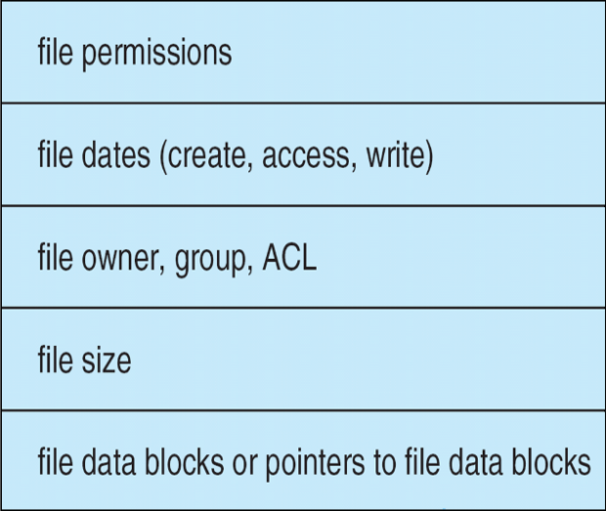
File System Implementation
on-disk and in-memory structures
On Disk Data Structures
Boot Control Block - Boot Control Block contains all the information which is needed to boot an operating system from that volume. It is called boot block in UNIX file system. In NTFS, it is called the partition boot sector.
Volume Control Block - Volume control block all the information regarding that volume such as number of blocks, size of each block, partition table, pointers to free blocks and free FCB blocks. In UNIX file system, it is known as super block. In NTFS, this information is stored inside master file table.
Directory Structure (per file system) -A directory structure (per file system) contains file names and pointers to corresponding FCBs.
File Control Block - File Control block contains all the details about the file such as ownership details, permission details, file size,etc. In UFS, this detail is stored in inode.
File control Block

Slide 86
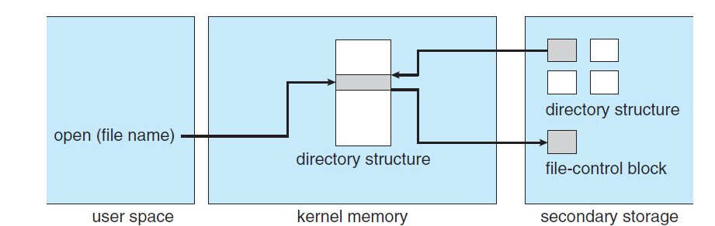
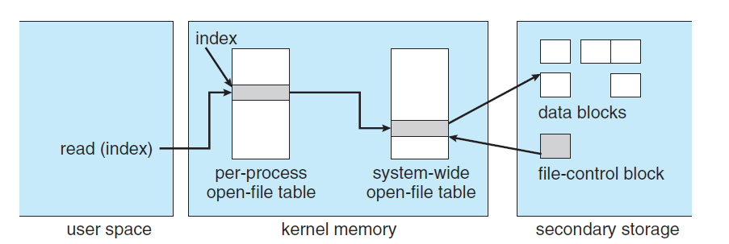
In-Memory File System Structures
The in-memory data structures are used for file system management as well as performance improvement via caching. This information is loaded on the mount time and discarded on ejection.

Slide 87
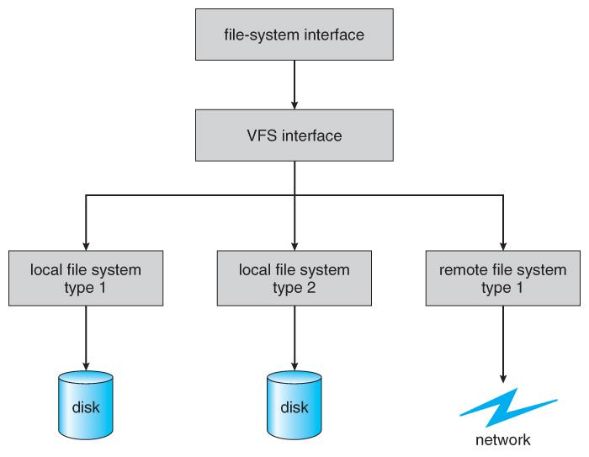
Virtual File Systems
Virtual File Systems, VFS, provide a common interface to multiple different filesystem types. In addition, it provides for a unique identifier ( vnode ) for files across the entire space, including across all filesystems of different types. ( UNIX inodes are unique only across a single filesystem, and certainly do not carry across networked file systems. )
The VFS in Linux is based upon four key object types:
The inode object, representing an individual file
The file object, representing an open file.
The superblock object, representing a filesystem.
The dentry object, representing a directory entry.

Slide 88
Directory Implementation
Directories need to be fast to search, insert, and delete, with a minimum of wasted disk space.
Linear List
A linear list is the simplest and easiest directory structure to set up, but it does have some drawbacks.
Finding a file ( or verifying one does not already exist upon creation ) requires a linear search.
Deletions can be done by moving all entries, flagging an entry as deleted, or by moving the last entry into the newly vacant position.
Sorting the list makes searches faster, at the expense of more complex insertions and deletions.
A linked list makes insertions and deletions into a sorted list easier, with overhead for the links.
More complex data structures, such as B-trees, could also be considered.
Hash Table
A hash table can also be used to speed up searches.
Hash tables are generally implemented in addition to a linear or other structure

Slide 89
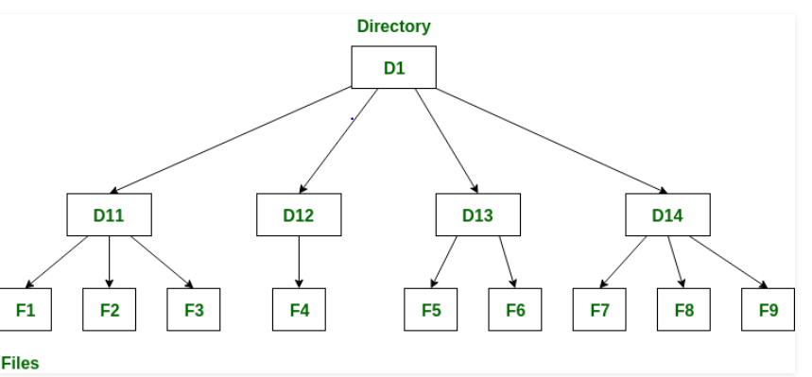
Directory Structure
A directory is a container that is used to contain folders and file. It organizes files and folders into a hierarchical manner.

Slide 90
Directory Structure(Contd…)
There are several logical structures of a directory, these are given below.
Single-level directory
Two-level directory
Tree-structured directory
Acyclic graph directory
General graph directory structure

Slide 91
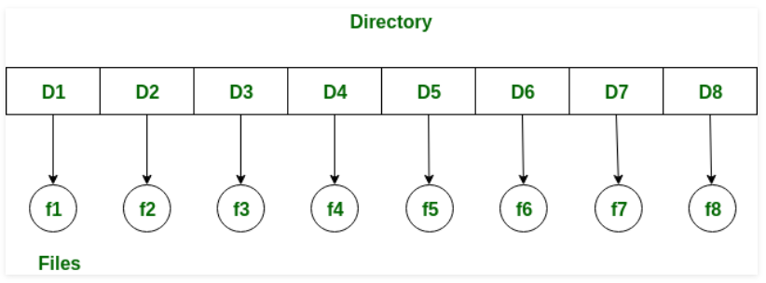
1. Single level Directory Structure
Single level directory is simplest directory structure. In it all files are contained in same directory which make it easy to support and understand.
A single level directory has a significant limitation, however, when the number of files increases or when the system has more than one user. Since all the files are in the same directory, they must have the unique name . if two users call their dataset test, then the unique name rule violated.

Slide 92
Single level Directory Structure(Contd…)
Advantages:
Since it is a single directory, so its implementation is very easy.
If the files are smaller in size, searching will become faster.
The operations like file creation, searching, deletion, updating are very easy in such a directory structure.
Disadvantages:
There may chance of name collision because two files can not have the same name.
Searching will become time taking if the directory is large.
In this can not group the same type of files together.

Slide 93
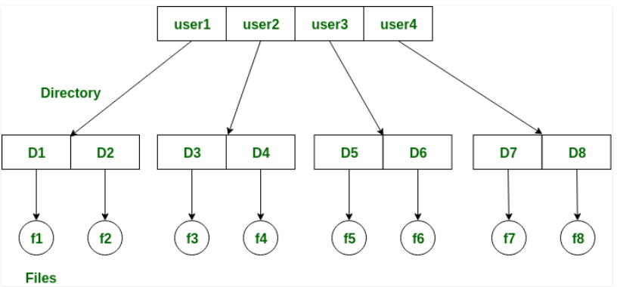
2. Two-level directory
As we have seen, a single level directory often leads to confusion of files names among different users. the solution to this problem is to create a separate directory for each user.
In the two-level directory structure, each user has there own user files directory (UFD). The UFDs has similar structures, but each lists only the files of a single user. system’s master file directory (MFD) is searches whenever a new user id=s logged in. The MFD is indexed by username or account number, and each entry points to the UFD for that user.

Slide 94
Two-level directory (contd…)
Advantages:
We can give full path like /User-name/directory-name/.
Different users can have same directory as well as file name.
Searching of files become more easy due to path name and user-grouping.
Disadvantages:
A user is not allowed to share files with other users.
Still it not very scalable, two files of the same type cannot be grouped together in the same user

Slide 95
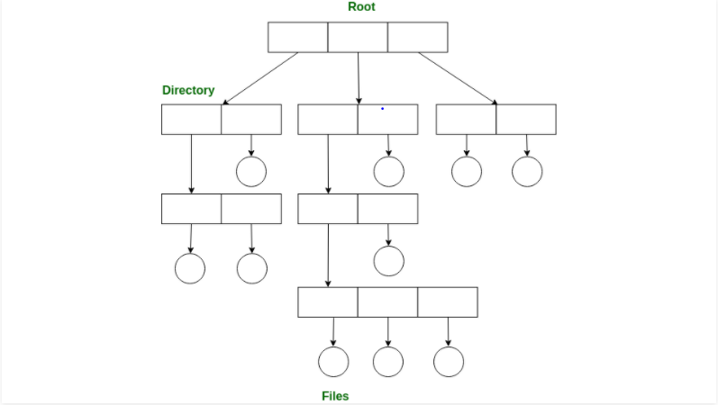
3. Tree-structured directory
Once we have seen a two-level directory as a tree of height 2, the natural generalization is to extend the directory structure to a tree of arbitrary height.
This generalization allows the user to create there own subdirectories and to organize on their files accordingly

Slide 96
Tree-structured directory(contd…)
A tree structure is the most common directory structure. The tree has a root directory, and every file in the system have a unique path.
Advantages:
Very generalize, since full path name can be given.
Very scalable, the probability of name collision is less.
Searching becomes very easy, we can use both absolute path as well as relative
Disadvantages:
Every file does not fit into the hierarchical model, files may be saved into multiple directories.
We can not share files.
It is inefficient, because accessing a file may go under multiple directories.

Slide 97
4. Acyclic graph directory
An acyclic graph is a graph with no cycle and allows to share subdirectories and files. The same file or subdirectories may be in two different directories. It is a natural generalization of the tree-structured directory.
It is used in the situation like when two programmers are working on a joint project and they need to access files. The associated files are stored in a subdirectory, separating them from other projects and files of other programmers, since they are working on a joint project so they want the subdirectories to be into their own directories. The common subdirectories should be shared. So here we use Acyclic directories.
It is the point to note that shared file is not the same as copy file . If any programmer makes some changes in the subdirectory it will reflect in both subdirectories.

Slide 98
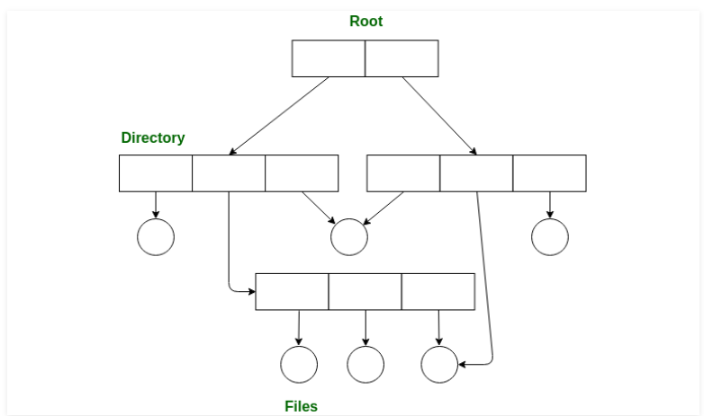
Acyclic graph directory(contd…)
Advantages:
We can share files.
Searching is easy due to different-different paths.
Disadvantages:
We share the files via linking, in case of deleting it may create the problem,
If the link is softlink then after deleting the file we left with a dangling pointer.
In case of hardlink, to delete a file we have to delete all the reference associated with it.

Slide 99
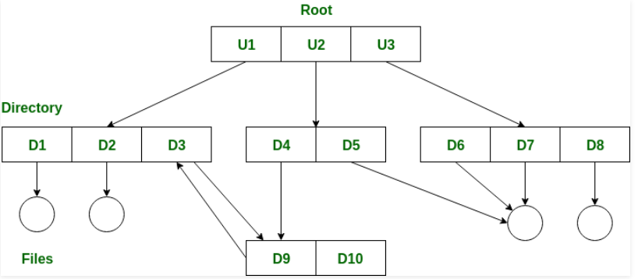
5. General graph directory structure
In general graph directory structure, cycles are allowed within a directory structure where multiple directories can be derived from more than one parent directory.
The main problem with this kind of directory structure is to calculate total size or space that has been taken by the files and directories

Slide 100
General graph directory structure(contd…)
Advantages:
It allows cycles.
It is more flexible than other directories structure.
Disadvantages:
It is more costly than others.
It needs garbage collection.

Slide 101
Allocation Methods
An allocation method refers to how disk blocks are allocated for files:
Contiguous allocation
Linked allocation
Indexed allocation

Slide 102
Contiguous Allocation
Each file occupies a set of contiguous blocks on the disk
Simple – only starting location (block #) and length (number of blocks) are required
Random access
Wasteful of space (dynamic storage-allocation problem)
Files cannot grow

Slide 103
Contiguous Allocation
Mapping from logical to physical
Block to be accessed = ! + starting address
Displacement into block = R
Q
LA/512
R

Slide 104
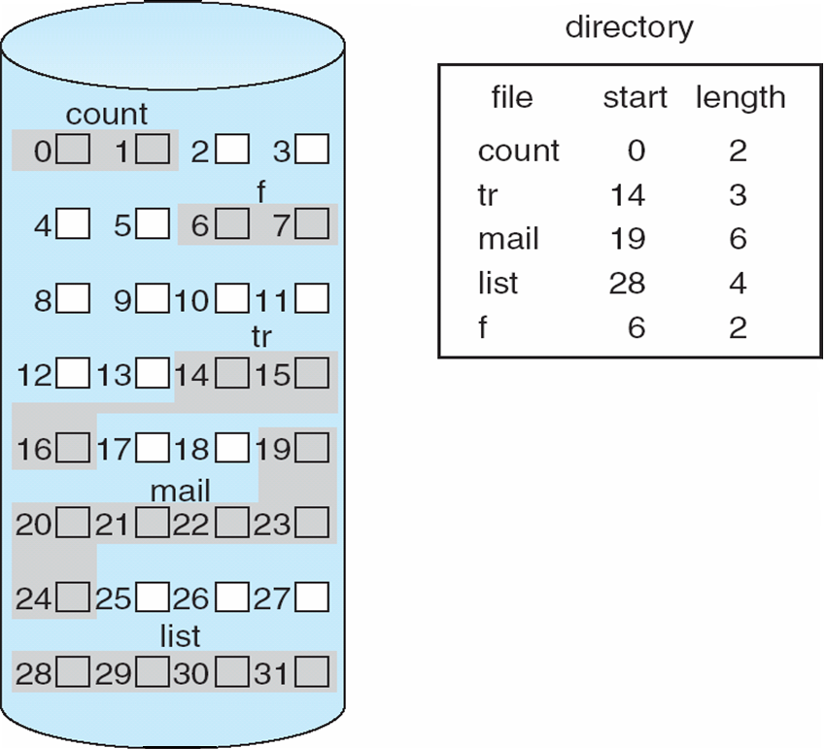
Contiguous Allocation of Disk Space

Slide 105
Extent-Based Systems
Many newer file systems (I.e. Veritas File System) use a modified contiguous allocation scheme
Extent-based file systems allocate disk blocks in extents
An extent is a contiguous block of disks
Extents are allocated for file allocation
A file consists of one or more extents

Slide 106
Linked Allocation
Each file is a linked list of disk blocks: blocks may be scattered anywhere on the disk.
block =
pointer

Slide 107
Linked Allocation (Cont.)
Simple – need only starting address
Free-space management system – no waste of space
No random access
Mapping
Block to be accessed is the Qth block in the linked chain of blocks representing the file.
Displacement into block = R + 1
File-allocation table (FAT) – disk-space allocation used by MS-DOS and OS/2.
Q
LA/511
R

Slide 108
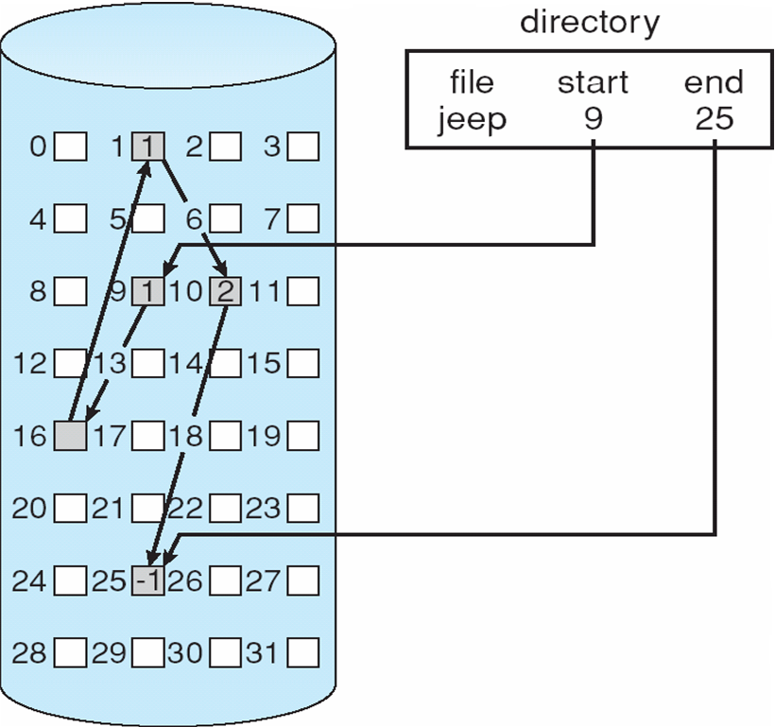
Linked Allocation

Slide 109
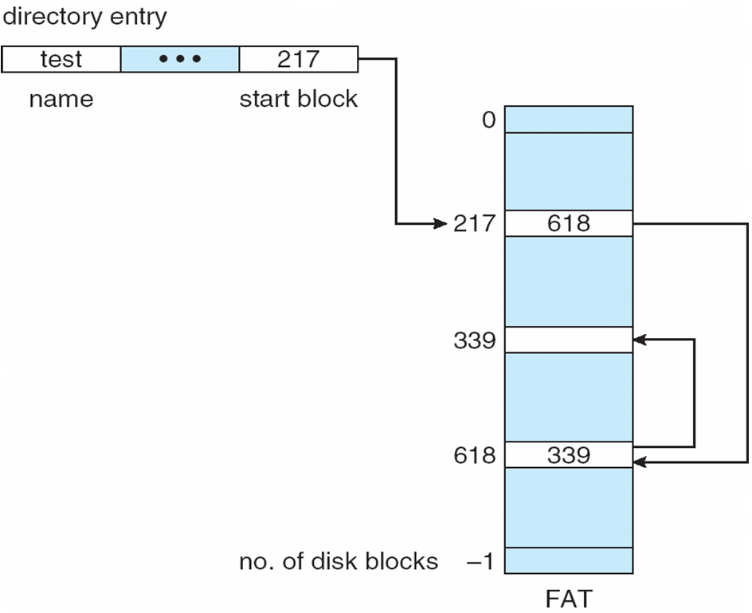
File-Allocation Table

Slide 110
Indexed Allocation
Brings all pointers together into the index block
Logical view
index table

Slide 111
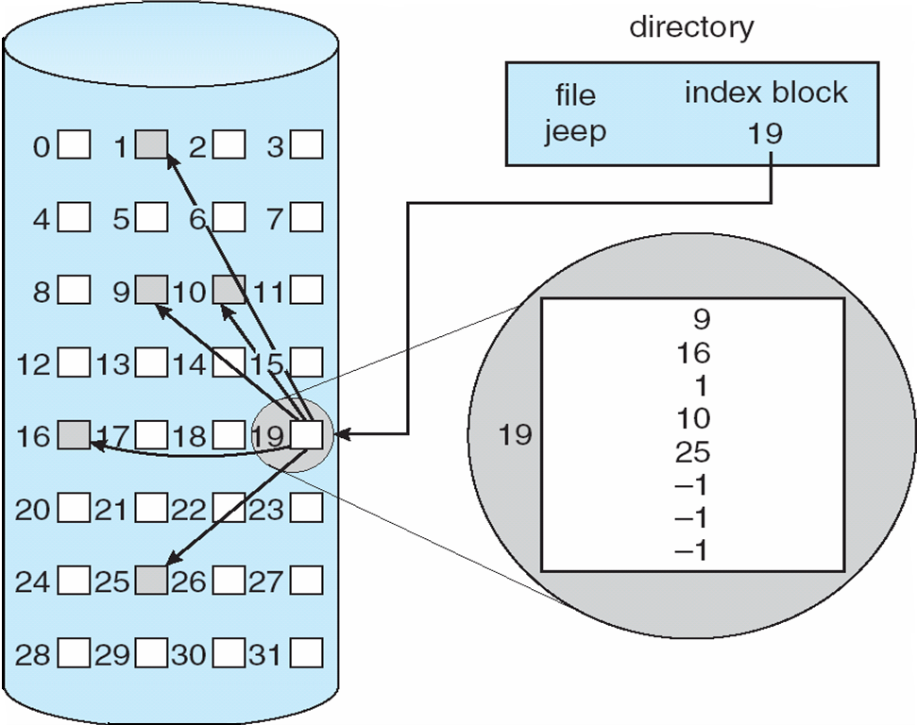
Example of Indexed Allocation

Slide 112
Indexed Allocation (Cont.)
Need index table
Random access
Dynamic access without external fragmentation, but have overhead of index block
Mapping from logical to physical in a file of maximum size of 256K words and block size of 512 words. We need only 1 block for index table
Q = displacement into index table
R = displacement into block
Q
LA/512
R

Slide 113
Indexed Allocation – Mapping (Cont.)
Mapping from logical to physical in a file of unbounded length (block size of 512 words)
Linked scheme – Link blocks of index table (no limit on size)
Q₁ = block of index table
R₁ is used as follows:
Q₂ = displacement into block of index table
R₂ displacement into block of file:
Q₁
LA / (512 x 511)
R₁
Q₂
R₁ / 512
R₂

Slide 114
Indexed Allocation – Mapping (Cont.)
Two-level index (maximum file size is 512³)
Q₁ = displacement into outer-index
R₁ is used as follows:
Q₂ = displacement into block of index table
R₂ displacement into block of file:
Q₁
LA / (512 x 512)
R₁
Q₂
R₁ / 512
R₂

Slide 115
Indexed Allocation – Mapping (Cont.)

outer-index
index table
file

Slide 116
Worksheet

Slide 117
Problem:1
Consider a file currently consisting of 100 blocks. Assume that the file-control block (and the index block, in the case of indexed allocation)is already in memory. Calculate how many disk I/O operations are required for contiguous, linked, and indexed (single-level) allocation strategies, if, for one block, the following conditions hold. In the contiguous-allocation case, assume that there is no room to grow at the beginning but there is room to grow at the end. Also assume that the block information to be added is stored in memory.
The block is added at the beginning.
The block is added in the middle.
The block is added at the end.
The block is removed from the beginning.
The block is removed from the middle.
The block is removed from the end.

Slide 118
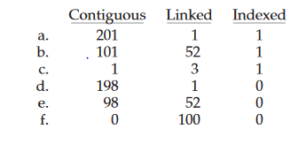
Answer

Slide 119
Problem:2
File of 101 blocks, file positions already in memory, and block to add already in memory. Every directory or index operation is done in memory. There is room on the disk after the file but not before. How many operations to...
1.Add a block at the beginning
2.Add a block after the 51st block
3.Add a block at the end
4.Remove the beginning block5.Remove the 51st block
6.Remove the end block

Slide 120
Free-Space Management
Bit vector (n blocks)
…
0 ⇒ block[i] free
1 ⇒ block[i] occupied
bit[i] =
(number of bits per word) *
(number of 0-value words) +
offset of first 1 bit

Slide 121
Free-Space Management (Cont.)
Bit map requires extra space
Example:
block size = 2¹² bytes
disk size = 2³⁰ bytes (1 gigabyte)
n = 2³⁰/2¹² = 2¹⁸ bits (or 32K bytes)
Easy to get contiguous files
Linked list (free list)
Cannot get contiguous space easily
No waste of space
Grouping
Counting

Slide 122
Free-Space Management (Cont.)
Need to protect:
Pointer to free list
Bit map
Must be kept on disk
Copy in memory and disk may differ
Cannot allow for block[i] to have a situation where bit[i] = 1 in memory and bit[i] = 0 on disk
Solution:
Set bit[i] = 1 in disk
Allocate block[i]
Set bit[i] = 1 in memory

Slide 123
Directory Implementation
Linear list of file names with pointer to the data blocks
simple to program
time-consuming to execute
Hash Table – linear list with hash data structure
decreases directory search time
collisions – situations where two file names hash to the same location
fixed size

Slide 124
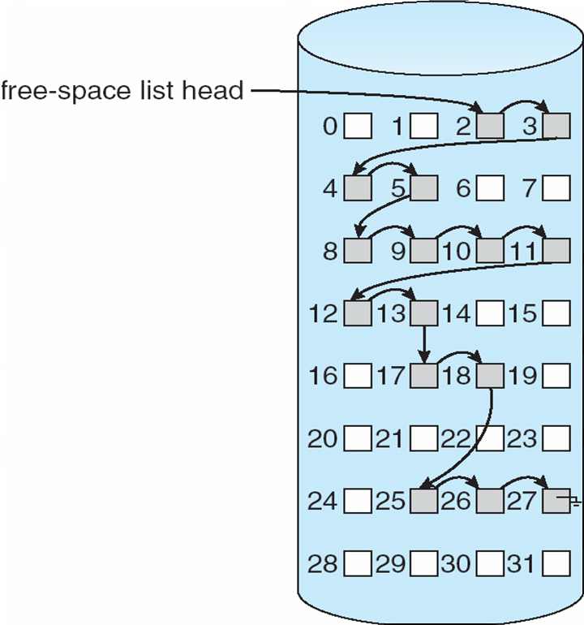
Linked Free Space List on Disk

Slide 125
Efficiency and Performance
Efficiency dependent on:
disk allocation and directory algorithms
types of data kept in file’s directory entry
Performance
disk cache – separate section of main memory for frequently used blocks
free-behind and read-ahead – techniques to optimize sequential access
improve PC performance by dedicating section of memory as virtual disk, or RAM disk

Slide 126
Free Space Management
Objectives :
Operating system maintains a list of free disk spaces to keep track of all disk blocks which are not being used by any file.
Whenever a file has to be created, the list of free disk space is searched for and then allocated to the new file.
A file system is responsible to allocate the free blocks to the file therefore it has to keep track of all the free blocks present in the disk.
Hence there is need for understanding the methods available for managing free space in the disk

Slide 127
Understanding the methods available for maintaining the free spaces in the disk
The system keeps tracks of the free disk blocks for allocating space to files when they are created.
Also, to reuse the space released from deleting the files, free space management becomes crucial.
The system maintains a free space list which keeps track of the disk blocks that are not allocated to some file or directory.

Slide 128
The free space list can be implemented mainly as:
1.Bitmap or Bit vector
A Bitmap or Bit Vector is series or collection of bits where each bit corresponds to a disk block.
The bit can take two values: 0 and 1: 0 indicates that the block is allocated and 1 indicates a free block.
The given instance of disk blocks on the disk in Figure 1 (where green blocks are allocated) can be represented by a bitmap of 16 bits as: 0000111000000110.

Slide 129
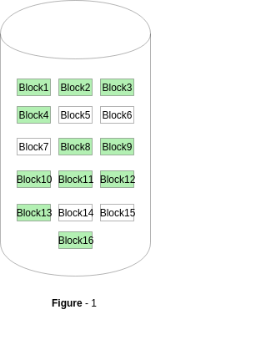
Bitmap or Bit vector
The block number can be calculated as: (number of bits per word) *(number of 0-values words) + offset of bit first bit 1 in the non-zero word .
For the Figure-1, we scan the bitmap sequentially for the first non-zero word.
The first group of 8 bits (00001110) constitute a non-zero word since all bits are not 0.
After the non-0 word is found, we look for the first 1 bit. This is the 5th bit of the non-zero word. So, offset = 5.
Therefore, the first free block number = 8*0+5 = 5.

Slide 130
Bitmap or Bit vector
Advantages
Simple to understand.
Finding the first free block is efficient. It requires scanning the words (a group of 8 bits) in a bitmap for a non-zero word. (A 0-valued word has all bits 0). The first free block is then found by scanning for the first 1 bit in the non-zero word.

Slide 131
2.Linked List
In this approach, the free disk blocks are linked together i.e. a free block contains a pointer to the next free block.
The block number of the very first disk block is stored at a separate location on disk and is also cached in memory.

Slide 132
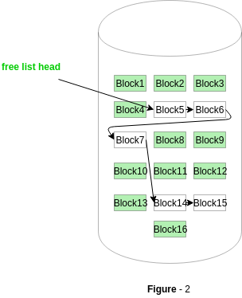
2.Linked List
In Figure-2, the free space list head points to Block 5 which points to Block 6, the next free block and so on.
The last free block would contain a null pointer indicating the end of free list.

Slide 133
3.Grouping
This approach stores the address of the free blocks in the first free block.
The first free block stores the address of some, say n free blocks.
Out of these n blocks, the first n-1 blocks are actually free and the last block contains the address of next free n blocks.
An advantage of this approach is that the addresses of a group of free disk blocks can be found easily.

Slide 134
4.Counting
This approach stores the address of the first free disk block and a number n of free contiguous disk blocks that follow the first block. Every entry in the list would contain:
Address of first free disk block
A number n
For example, in Figure-1, the first entry of the free space list would be: ([Address of Block 5], 2), because 2 contiguous free blocks follow block 5.

Slide 135
Swap-Space Management
Swapping is a memory management technique used in multi-programming to increase the number of process sharing the CPU.
It is a technique of removing a process from main memory and storing it into secondary memory, and then bringing it back into main memory for continued execution.
This action of moving a process out from main memory to secondary memory is called Swap Out and the action of moving a process out from secondary memory to main memory is called Swap In.

Slide 136
Swap-Space Management
Swap-space — virtual memory uses disk space as an extension of main memory.
Main goal for the design and implementation of swap space is to provide the best throughput for VM system
Swap-space use
Swapping – use swap space to hold entire process image
Paging –store pages that have been pushed out of memory
Some OS may support multiple swap-space
Put on separate disks to balance the load
Better to overestimate than underestimate
If out of swap-space, some processes must be aborted or system crashed

Slide 137
Swap-Space Location
Swap-space can be carved out of the normal file system, or in a
separate disk partition.
A large file within the file system: simple but inefficient
Navigating the directory structure and the disk-allocation data structure takes time and potentially extra disk accesses
External fragmentation can greatly increase swapping times by forcing multiple seeks during reading or writing of a process image
Improvement
Caching block location information in main memory
Contiguous allocation for the swap file
But, the cost of traversing FS data structure still remains

Slide 138
Swap-Space Location
In a separate partition: raw partition
Create a swap space during disk partitioning
A separate swap-space storage manager is used to
allocate and de-allocate blocks
Use algorithms optimized for speed, rather than storage efficiency
Internal fragment may increase
Linux supports both approaches

Slide 139
Swap-space Management: Example
Solaris 1
Text-segment pages are brought in from the file system and are thrown away if selected for paged out
More efficient to re-read from FS than write it to the swap space
Swap space: only used as a backing store for pages of
anonymous memory
Stack, heap, and uninitialized data
Solaris 2
Allocates swap space only when a page is forced out of physical memory
Not when the virtual memory page is first created.

Slide 140
Thank you

